Slide 1
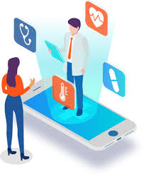
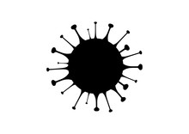
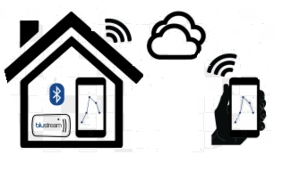
.
HEALTHCARE
AND
JK
MEDICINE

Slide 2
TEAM NAME AND MEMBERS DETAILS :
MEMBERS | NAME | EMAIL ID
MEMBER 1 | SELCIYA P | selciya392001@gmail.com
MEMBER 2 | CHRISTY BERLIN T | christyberlin2002@gmail.com
MEMBER 3 | SUVEDHA S | ssuvedha2002@gmail.com
MEMBER 4 | RAMAMOORTHY S | kts.ramamoorthy07@gmail.com

Slide 3


PROBLEM TO BE SOLVED
40% of confirmed cases reported mild disease. ie treatment can be managed at home.
Solution to prevent the direct observation of patients by care taker.
PROBLEM
SOLUTION
Monitoring
Lack of monitoring and alerting devices ,danger of spread of diseases to others .
Care taker have to be educated to treat patients.
Wearable devices
Monitoring health status of an individual using wearable sensor without regular interval of time.
To update the patients health condition to hospital and care taker .

Slide 4
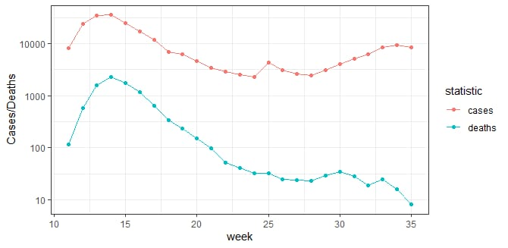
OUR SOLUTION
We aim at :
To build a solution which will monitor affected individuals.
This is done by collecting information using wearable
sensor like heartbeat , blood pressure , temperature
and saturation.
The collected data is send to the Arduino .
Here we use machine learning , this is use
to separate the data asserious and non - serious
condition .
If the patient condition is in serious condition it will send immediate phone call to
ambulance, hospital and care taker with a GPS location
Also we used app system , this will update the regular health status of patient to
hospital and care taker.

Slide 5

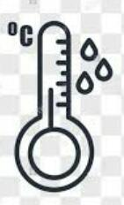







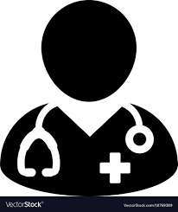
TECHNOLOGY USED
NTC Thermistors
Blood pressure sensor
GPS
APPLICATION
Care taker
SENSORS
Ambulance
Patient details to be recording
Heart beat sensor
Pulse oximeter
Doctor

Slide 6
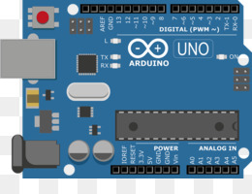

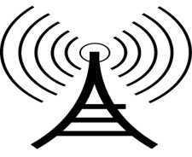
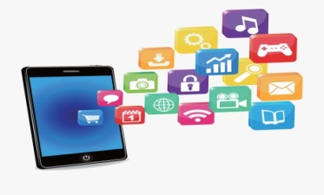
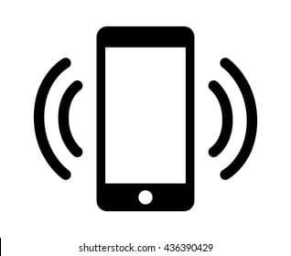
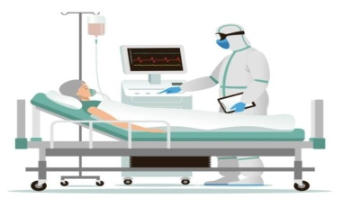
WORKING ARCHITECTURE
App monitoring & Machine learning processing
Phone call to care taker and hospital
Data from wearable devise
Hospital care will be given

Slide 7


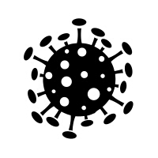

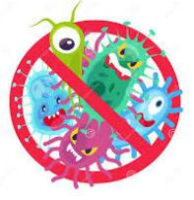
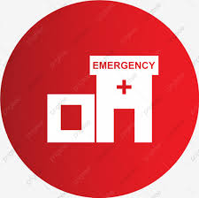
NECESSICITY:
Monitor the vital health parameter like temperature, oxygen level and other at least twice a day
It is simple and automatic device so there is no need for educating about device and it’s working.
Less travel time during pandemic situation.
Call the health care centre and care taker immediately if the ill person worsens or experience difficulty breathing.
Decrease infection exposure and transmission

Slide 8

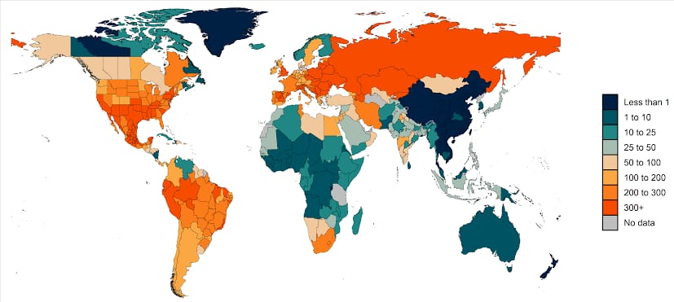
TOTAL DEATH RATE DUE TO COVID -19 AROUND WORLD

Slide 9
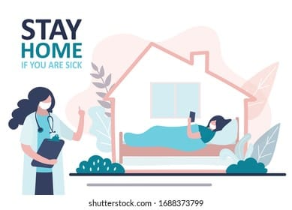

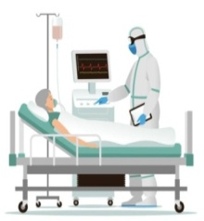
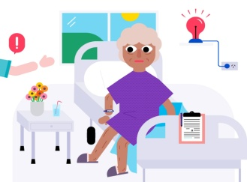
BUSINESS MODEL
Used to monitor other disease like stroke, heart patients and syncope conditions
It can be used to monitor both critical and mild serious conditions patient in the hospital.
It can be used for monitoring covid isolated patients at home

Slide 10
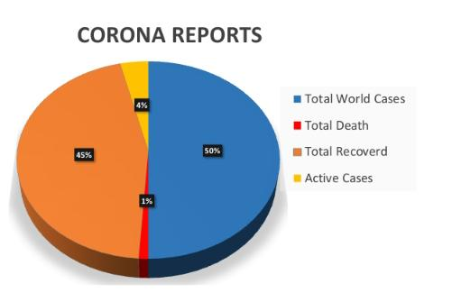
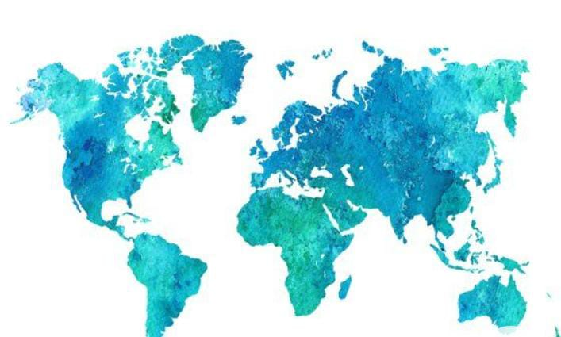
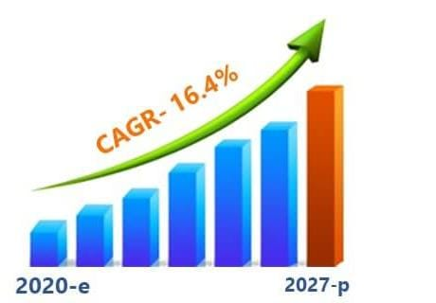
MARKET ANALYSIS
NORTH AMERICA
APAC
Largest market by region
Fastest-growing
market by region
2030 MARKET SIZE $144.2
BILLION
2020 MARKET SIZE $27.8 BILLION
MARKET GROWTH RATE (2020-2030) 15.8%
MARKET IMPACT
This market will have a positive impact due spread
Of covid - 19

Slide 11
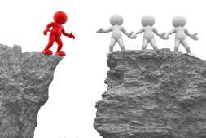

CURRENT
GAPS
Existing | Our solution
1. High cost efficient | 1. Low cost efficient
2. Data storage and acquisitions is high | 2. Huge processing in a compact board
3. Does not inform hospital and ambulance in case of emergency | 3. Inform to hospital , care taker and ambulance in case of emergency
4. No other advanced process is used | 4. Machine learning is used to separate patients health data into serious and non serious condition

Slide 12
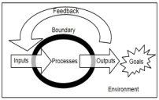



CHALLENGES
The system works only when there is a change in the readings
No patent occurs
The resources are not mostly available in sources
Trial-and-error calibration and servicing is ineffect

Slide 13



